Slide 1


Slide 2
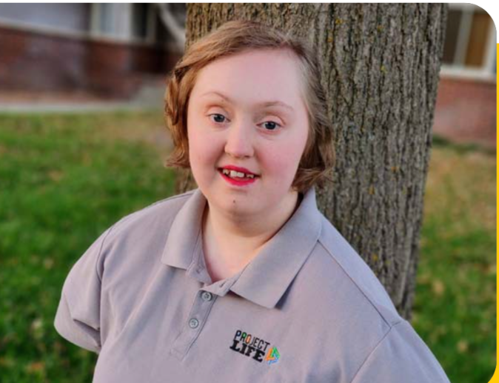
Presentation Overview
History of the ABLE Savings Program
What is an ABLE account?
Who is Eligible?
How Do You Open an ABLE Account?
How Much Can You Contribute?
How to Spend and Withdraw Your Funds?
Kansas ABLE Empowerment Grant

Slide 3
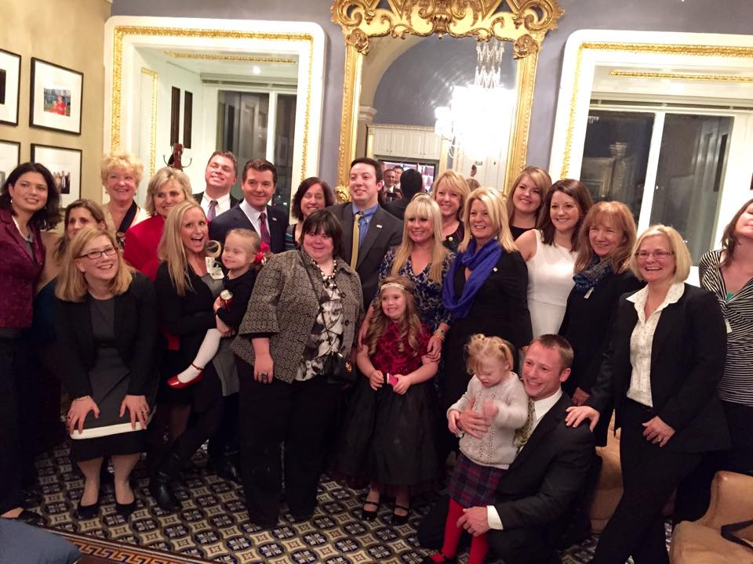
The Stephen Beck, Jr.
Achieving a Better Life Experience Act of 2014
ABLE Act on December 19th of 2014.
Notes:
This is a bill for the disability community by the disability community.
Senators Robert Casey Jr. (D-PA) and Richard Burr (R-NC) and Representatives Crenshaw (R-FL), Cathy McMorris Rodgers (R-WA), Chris Van Hollen (D-MD) and Pete Sessions (R-TX), along with their Congressional staffs, ultimately led the passage of ABLE Act in the 113th Congress with disability advocates. After many years of advocacy, the momentum behind the ABLE Act intensified in the 113th Congress after the bill continued to receive record-breaking cosponsors and media attention.
Stephen Beck Jr succeed in getting the first piece of legislation affecting people with disabilities through Congress in 25+ years. The ABLE Act is named after the late Stephen Beck Jr., a father of two daughters – Mariae Rose and Natalie – who made it his life’s passion to ensure that Natalie, who happens to have Down syndrome, had the same opportunities to save as everyone else. On December 3rd, 2014, the US House of Representatives passed the ABLE Act 404-17. The US Senate passed the ABLE Act as part of the Tax Extenders Package on December 17th, 2014. The Stephen Beck Jr. ABLE Act was signed into law on December 19th, 2014 by President Barack Obama as part of the end of the year tax extenders package.
In February 2014, Sara Wolff authored a change.org petition calling on Congress to pass the ABLE Act. Sara was motivated by her personal journey of losing her incredible mother to cancer. Sara’s petition garnered more than 260,000 signatures and her petition and message served as the catalyst for building national momentum and political support behind the ABLE Act, including a legislative endorsement by the New York Times.
On July 23, 2014, the Senate Finance Subcommittee on Taxation and IRS Oversight held a Congressional hearing entitled, Saving for an Uncertain Future: How the ABLE Act can Help People with Disabilities and their Families, where Sara Wolff testified.
On July 31st, 2014, the House Ways and Means Committee unanimously passed the ABLE Act out of Committee.

Slide 4
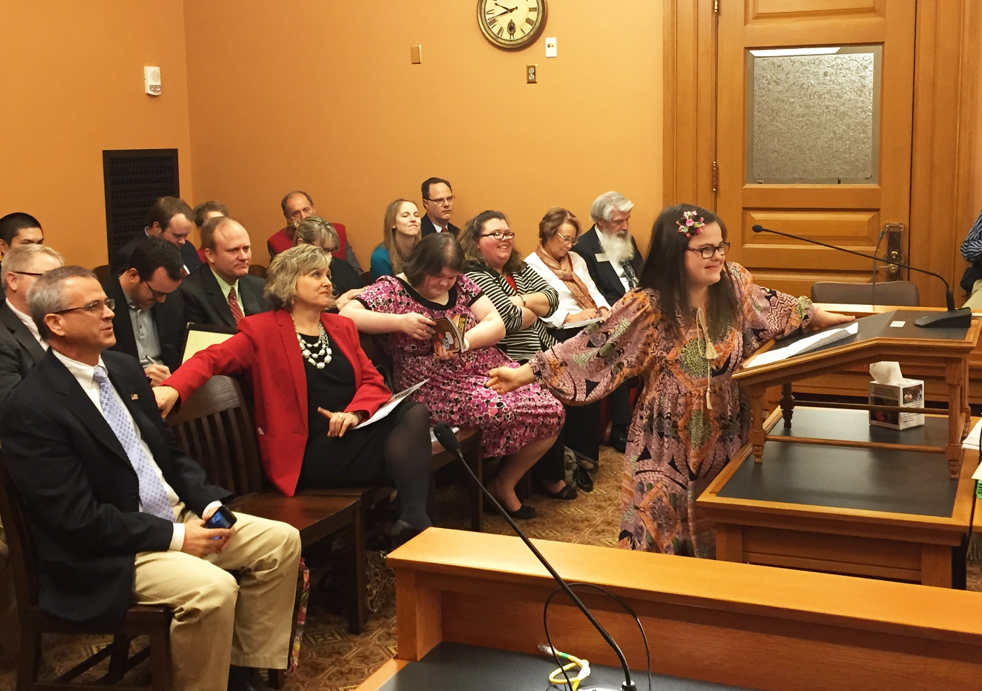
Kansas ABLE Act
The Mast family reached out to State Treasurer Ron Estes for his assistance in drafting of the State version of the ABLE Act.
Rep. Davis & our office introduced the Kansas ABLE Act (HB 2216) on January 22nd, 2015.
The ABLE Act moved quickly, passing the Kansas Senate on March 25th, then passing the Kansas House on April 1st.
On April 15th, 2015 Governor Brownback signed the Kansas ABLE Act into law.
Notes:
Jawanda Mast and her daughter, Rachel Mast, teamed up with Kansas State Representative Erin Davis to push for passage of the ABLE legislation. Jawanda and Representative Davis reached out to State Treasurer Ron Estes for his assistance in drafting of the State version of the ABLE Act. Representative Davis and our office introduced the Kansas ABLE Act on January 22nd, 2015. The ABLE Act moved quickly though the legislators, passing in the Kansas Senate on March 25th, then passing the Kansas House of Representatives on April 1st.

Slide 5
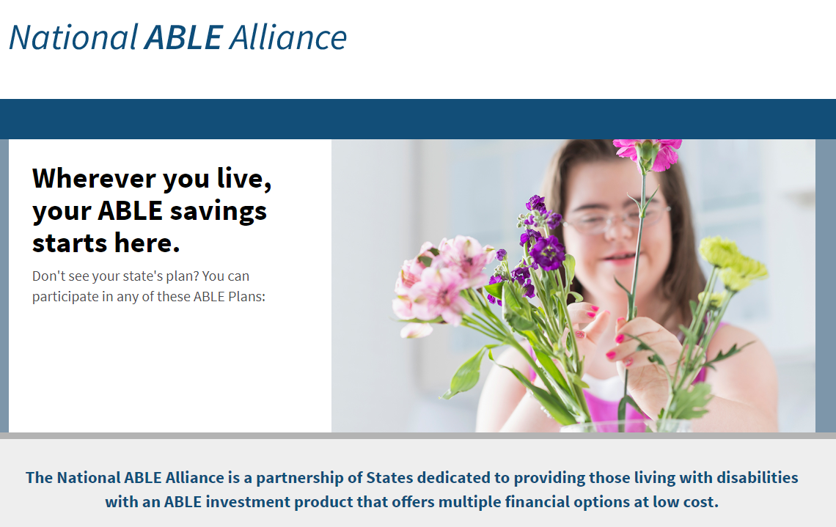
Notes:
Once the legislation was passed, Kansas along with 8 other states, formed an alliance for the purpose to open more accounts and lower account fees at a quicker rate, as one entity or team. It is usually a majority vote, but the direction of KS is the same as 19 other states currently, with ABLE account policies.
When 529 education savings first began, there were substantial fees with it. Now, there are no fees due to the expansion of assets that are managed. This is the same initiative that we have to the Kansas ABLE accounts

Slide 6
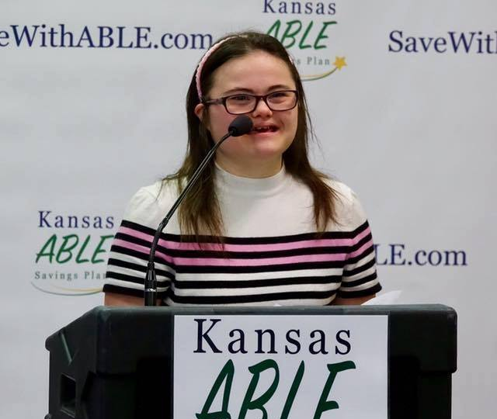
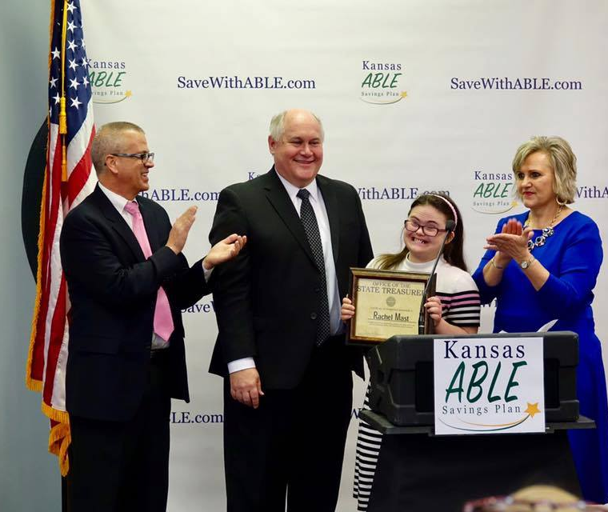
First Kansas ABLE Account Opened – January 26th, 2017
Notes:
Rachel Mass opened the first account on January 26th, 2017.
Rachels goal was to buy a pink house with an ABLE account one day. Ron gave her a pink tool kit for when she has her pink house one day, for home repairs.

Slide 7
What is an ABLE Account?
Tax-advantaged savings account (529A) that qualified individuals with disabilities can open.
Contributions are made on an after-tax basis.
Earnings grow tax-deferred and are tax-free if used for qualified disability expenses.
Contributions may be made by anybody.
The beneficiary is the owner of the account, but legal guardianship and powers of attorney will permit others to contribution funds, in the event that the beneficiary is unwilling or unable to manage the account.
Notes:
- An ABLE account is a tax-advantaged savings accounts (529A) that qualified individuals will disabilities can open.
- Contributions to an ABLE account are made on an after-tax basis.
- Earnings from ABLE funds grow tax-deferred and are tax-free if used for qualified disability expenses.
- Contributions to an ABLE account may be made by anybody.
- The beneficiary is the owner of the account, but legal guardianship and powers of attorney will permit others to control ABLE funds, in the event that the beneficiary is unwilling or unable to manage the account.

Slide 8
Eligibility Criteria
Age Requirement:
Qualifying disability must have first onset prior to age 46.
Disability Qualification:
Written diagnosis from a qualified medical professional.
Severity of Disability Determination:
A disability of the severity that would qualify the individual for SSI or SSDI benefits.
Can open an account at any age.
Notes:
Who is eligible to open an ABLE account?
- An individual must meet two requirement to be eligible for an ABLE account: an age requirement and a severity of disability determination.
- The onset of symptoms of the person’s disability must have occurred before the age of 26. Additionally, the disabled individual must have “marked and severe functional limitations.” (Essentially, the Social Security definition of disability.)
- An individual whose disability occurred prior to age 26 and is already receiving SSI and/or SSSDI is automatically eligible to establish an ABLE account.
- Those who are not recipients of SSI and/or SSDI, but still meet the age of onset disability requirement will be eligible to open an ABLE account upon obtaining a disability certification from their physician and filing their certification with the US Secretary of the Treasury.

Slide 9

Means-tested benefits and ABLE
Individuals can only have $2,000 in “countable assets” to remain eligible for many means-tested benefits programs, such as Supplemental Security Income (SSI) and Medicaid.
Funds in an ABLE account will not affect eligibility for SSI (up to $100,000), Medicaid and many other means-tested benefits.

Slide 10


ABLE Versatility
Choose from:
(a) Checking and savings options
- FDIC insured
(b) Market-based investment options
- stocks, bonds, money market, etc.
CHECKING
INVESTMENTS
Notes:
Type your notes

Slide 11
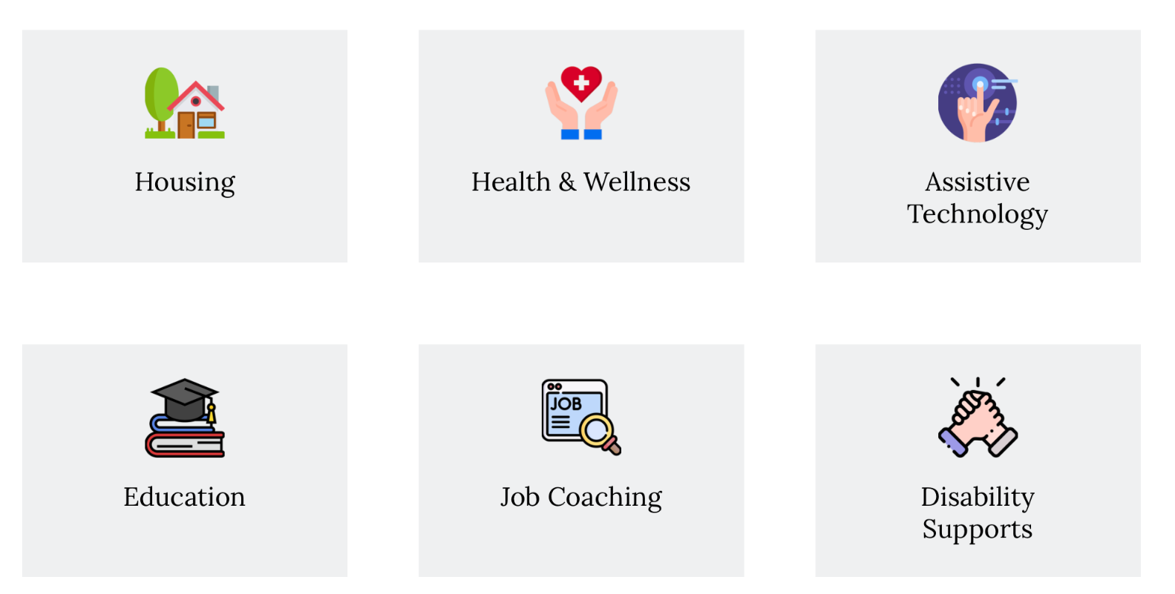
How to Use Your ABLE Account
Kansas ABLE accounts are designed to help pay for the account owner’s “Qualified Disability Expenses (QDEs),” which include: education, housing, transportation, employment training and support, assistive technology and related services, health, prevention and wellness, financial management and administrative services, legal fees, expenses for Kansas ABLE account oversight and monitoring, basic living expenses, etc.

Slide 12
Limitations to Contributions
Total Annual Contributions MAXIMUM is $20,000.
For state tax free contribution.
Contributions will no longer be allowed when the balance reaches $550,000.
Note: The account may grow beyond $550,000.
Notes:
Are there limits to how much money can be put in an ABLE account?
- Yes. The total annual contribution maximum to an ABLE account is $19,000.
- Contributions into the account will no longer be allowed when the balance reaches $501,000.
- NOTE: The account may grow beyond $501,000.
Tied to the federal gift tax limit. Just updated and this will grow every time that the bump the federal gift tax limit up.
Right now, it is $19,000 from one person to the other. This is from all people though. You can’t have multiple people contribution $19,000 into an account per year. This is an annual aggregate limit.
The lifetime aggregate amount for contributions is determined by the state and is parallel to the 529 plan. KS determines it by looking at the top 5 colleges in KS to determine the amount. This is reevaluated each year and the lifetime contribution amount is changed. The aggregate amount will most likely always changed because of the rising price of education.

Slide 13
ABLE to Work
Kansas ABLE Account Owners who earn income can contribute additional funds (up to $15,650) beyond the Annual Contribution Limit of $20,000.
It is the Account Owner's or Authorized Individual's responsibility to ensure that the Annual Contribution Limit is not exceeded.
The ABLE to work contribution benefit of $15,650 is subject to change annually as the U.S. Department of Health and Human Services (HHS) updates it’s Poverty Guidelines.

Slide 14
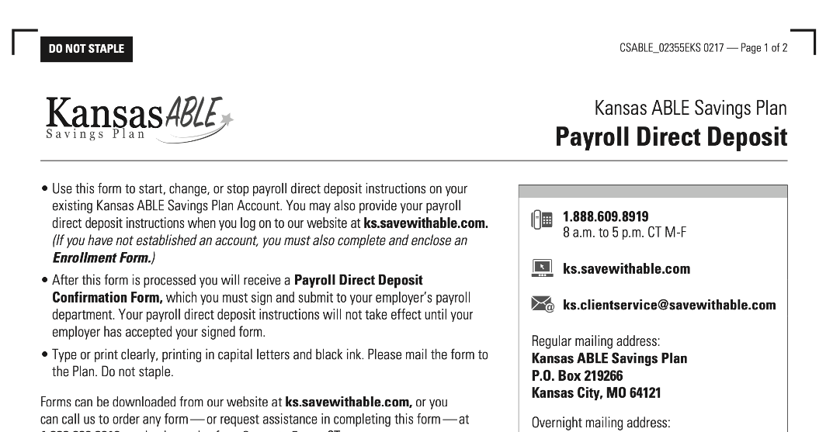
ABLE PAYROLL DEDUCTION

Slide 15

ABLE Account Enrollment
Enroll online or through a paper application.
Adults with legal capacity may open and manage their own ABLE account.
Directly or through a designated agent under a Power of Attorney.
Or, the following ”Authorized Individuals” can open and manage an account for someone without capacity (in order of priority):
Power of Attorney
Conservator or Guardian
Spouse, Parent, Sibling, Grandparent, or
SSA-appointed Representative Payee
KS.SaveWithABLE.com
Notes:
Power of Attorney – Executed Agreement
Conservator – Judicially appointed.
Guardian – Kansas limits the amount of financial oversite to $10,000. Be aware of your situation and be prepared to take additional steps if necessary.
At 18, the account becomes theirs. If you want to be the authorized agent for the account and to have access to the account, then you will need to have this prepared prior to the 18th birthday of the account owner/beneficiary.

Slide 16
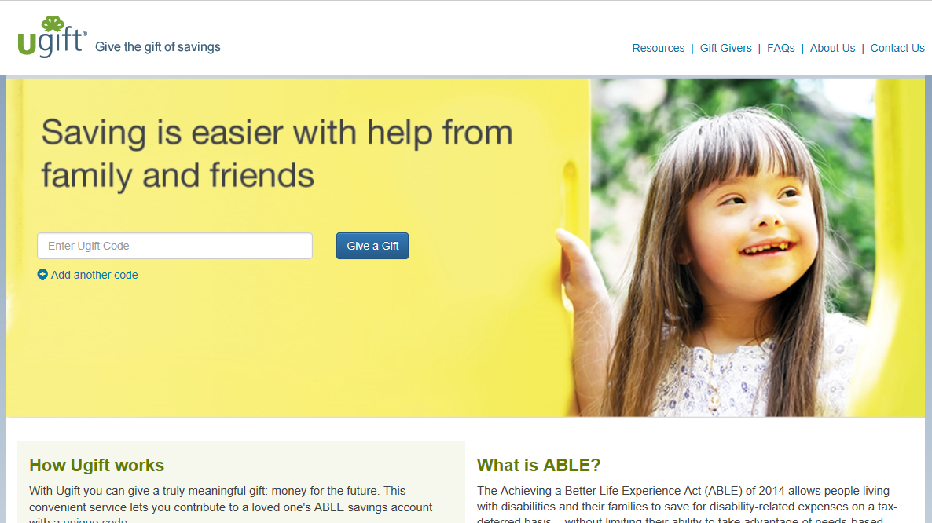
UgiftABLE.com
Notes:
Ugift is an easy, free-to-use service that lets friends and family contribute directly into a loved one's ABLE plan account in lieu of traditional gifts. All gift contributions sent in via Ugift are invested into the account owner's ABLE plan account and can be used to pay for disability-related expenses. ABLE plan account owners can easily use Ugift by getting a Ugift code that can be entered by family and friends to contribute at any time on UgiftABLE.com.

Slide 17
Tax Advantages
Federal Tax Benefits: Tax-free growth on earnings.
Kansas State Tax Benefits: Contributions may be deductible on state income tax. Kansas taxpayers can deduct up $3,000 per individual, or $6,000 if married filing jointly, annually for contributions to an ABLE account (or a qualified tuition program under 26 U.S.C. § 529).
No Impact on Means-Tested Benefits: Funds in the account do not affect eligibility for Medicaid, SSI, or other means-tested programs.

Slide 18
Q: Will ABLE account owners need approval before spending the money in their accounts?
A: No verification or approval of expenses from an ABLE account required. Account owners will, however, be required to maintain documentation to prove that their expenses are qualified if they are audited.
Q: What are the penalties for a ”Nonqualified Withdrawals”
A: Account owners will have to pay taxes on earnings plus pay a 10% federal tax penalty for distributions not used for qualified expenses.
Notes:
Will ABLE account owners need approval before spending the money in their accounts?
- No. No one has to verify or approve expenses from an ABLE account.
- Account owners will however be required to maintain documentation to prove that their expenses are qualified if they are audited.
I want you to think about how you use the ABLE account. One thing to think about with an ABLE account is because you should keep track of the funds that are spent, I would recommend to use your traditional bank account to buy items that are lower in costs and harder to track individually. Ideally, you should use your ABLE account for recurring expenses or large purchases that are easier to track.

Slide 19
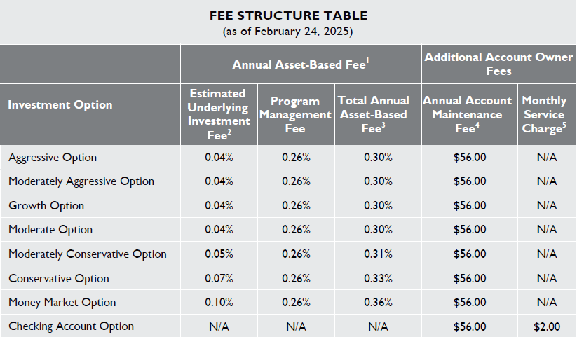
ABLE Account Investment and Maintenance Fees
Fee Reduction:
Electronic delivery reduces Quarterly Fee by $6.25.
Kansas residents get an extra quarterly discount of $1.25.
Quarterly Maintenance fee after both fee deductions: $6.50

Slide 20

Benefits to an ABLE FDIC checking account
Debit card access and unlimited check writing.
No overdraft or non-sufficient funds fees.
FDIC insurance up to maximum amount permitted by law ($250,000).
Interest growth on balances.
Tax advantages – pay no taxes on interest earned or on withdrawals used for qualified expenses such as health care, housing, transportation or education.
Paper or online statement options.
No Monthly Service Charge of $2.00 If You:
  Have an average monthly balance of $250 or more during your statement cycle.
  OR sign up for paperless statements.

Slide 21

Important Considerations
The Kansas State Treasurer’s Office cannot provide legal investing, or tax advice. Please consult qualified advisors to obtain advice applicable to your unique situation.
All investments carry a degree of risk. ABLE accounts, principal, and investment returns are not insured by the Kansas State Treasurer’s Office or the State of Kansas. Please carefully consider your options before opening or investing in an ABLE account.
The information here is a general summary, and additional details, considerations, and limitations may apply. Please review the full Program Disclosures before investing (available at SaveWithABLE.com/KS).

Slide 22
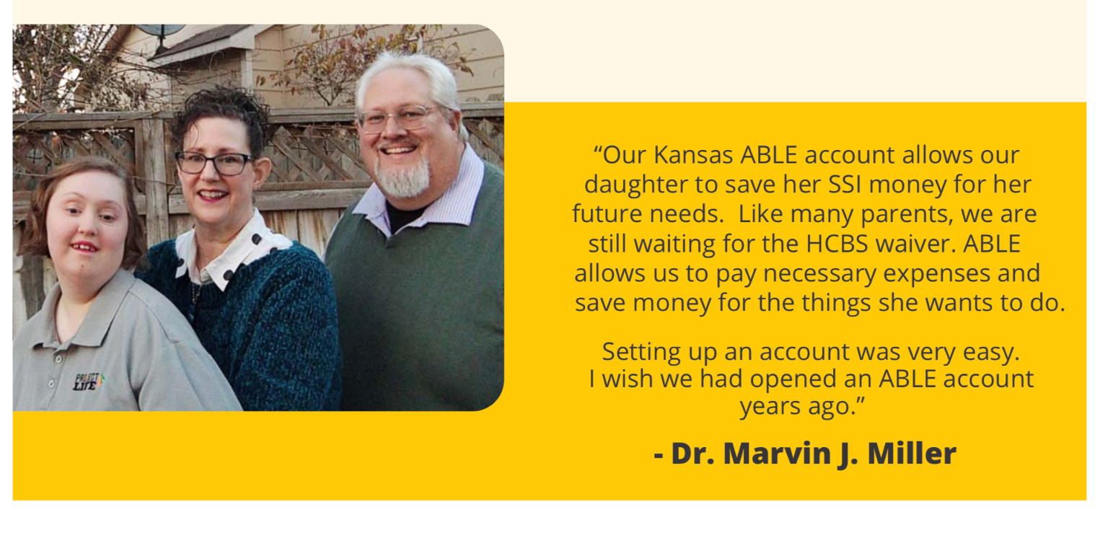

Slide 23
Kansas ABLE Empowerment Grant
All ABLE eligible Kansans or their loved ones who complete the following three steps qualify to receive a $100 Kansas ABLE Empowerment Grant:
Visit KansasCash.ks.gov/grant to apply for opportunity grant dollars by submitting your name or the name of another individual. The submitted name applying for the grant must ABLE eligible.
Attend an in-person or virtual informational class about the Kansas ABLE Savings Program.
Establish a Kansas ABLE savings account by July 1st 2026.
For questions, please contact: ABLEgrant@treasurer.ks.gov or 785.296.3342

Slide 24


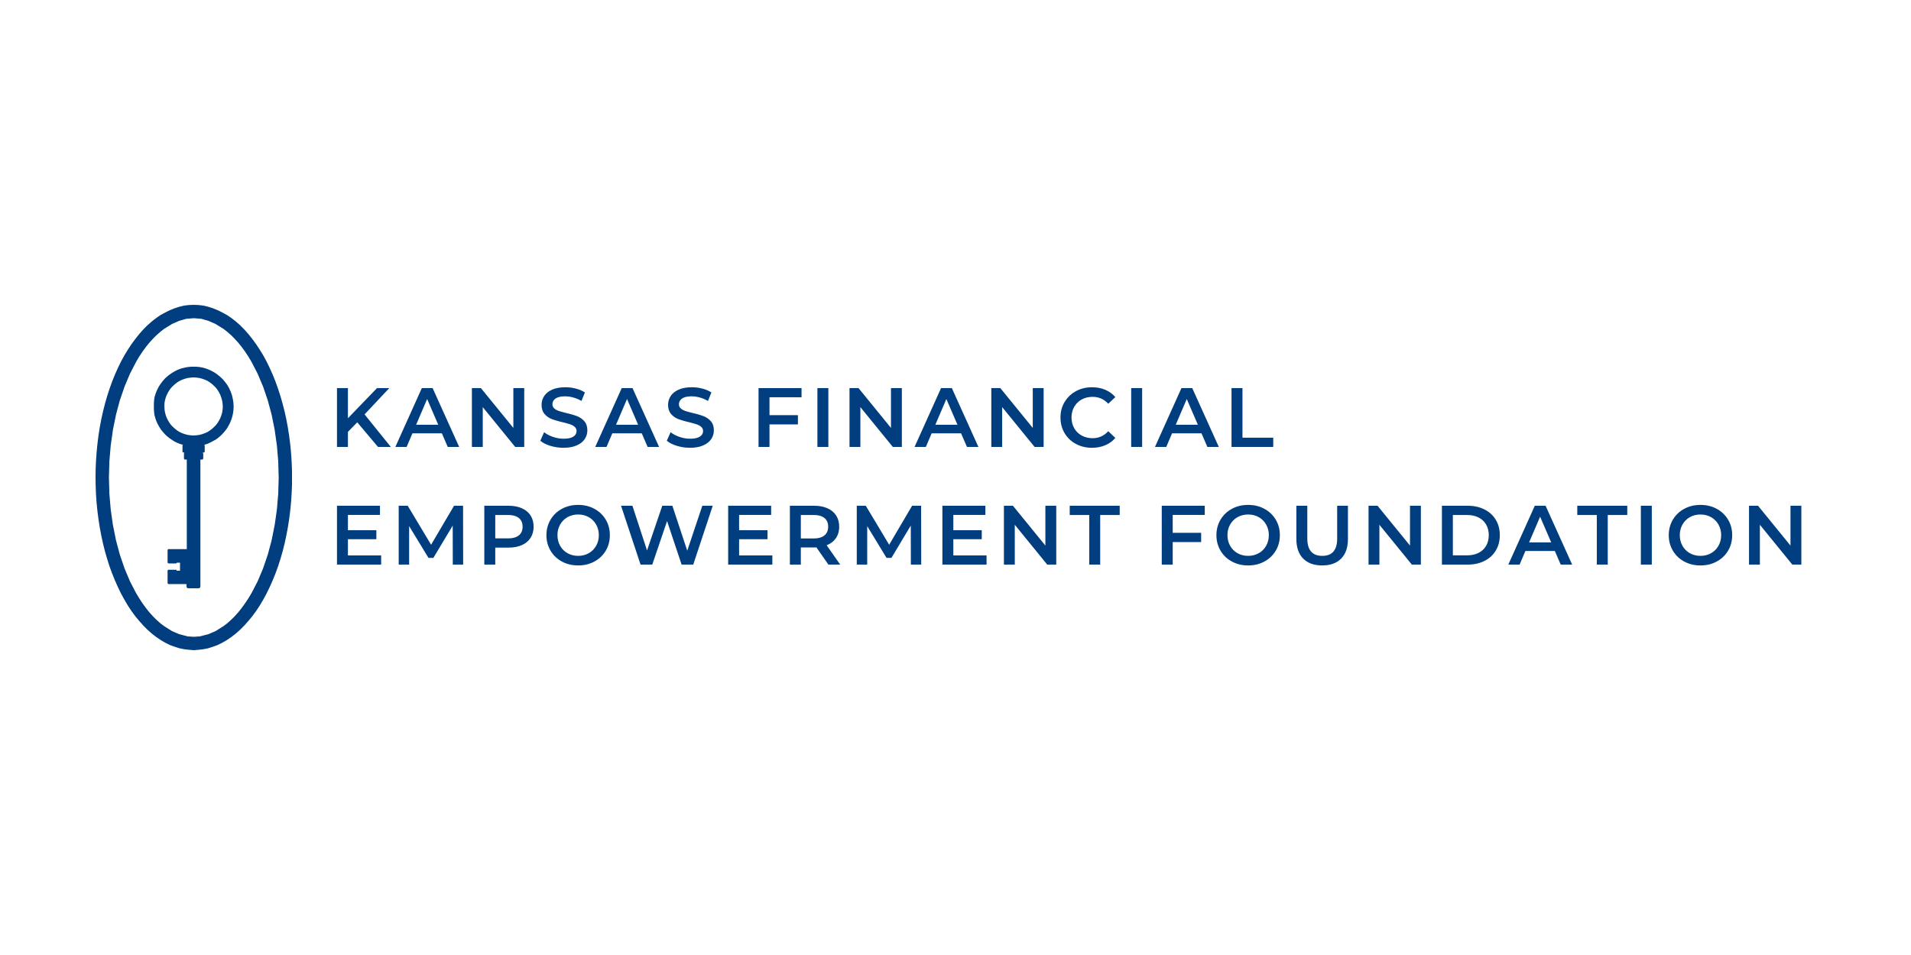
Thank You to Our ABLE Empowerment Grant Sponsors!

Slide 25
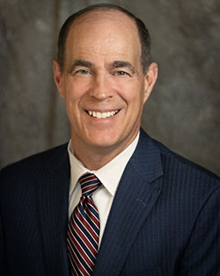
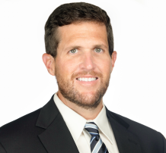
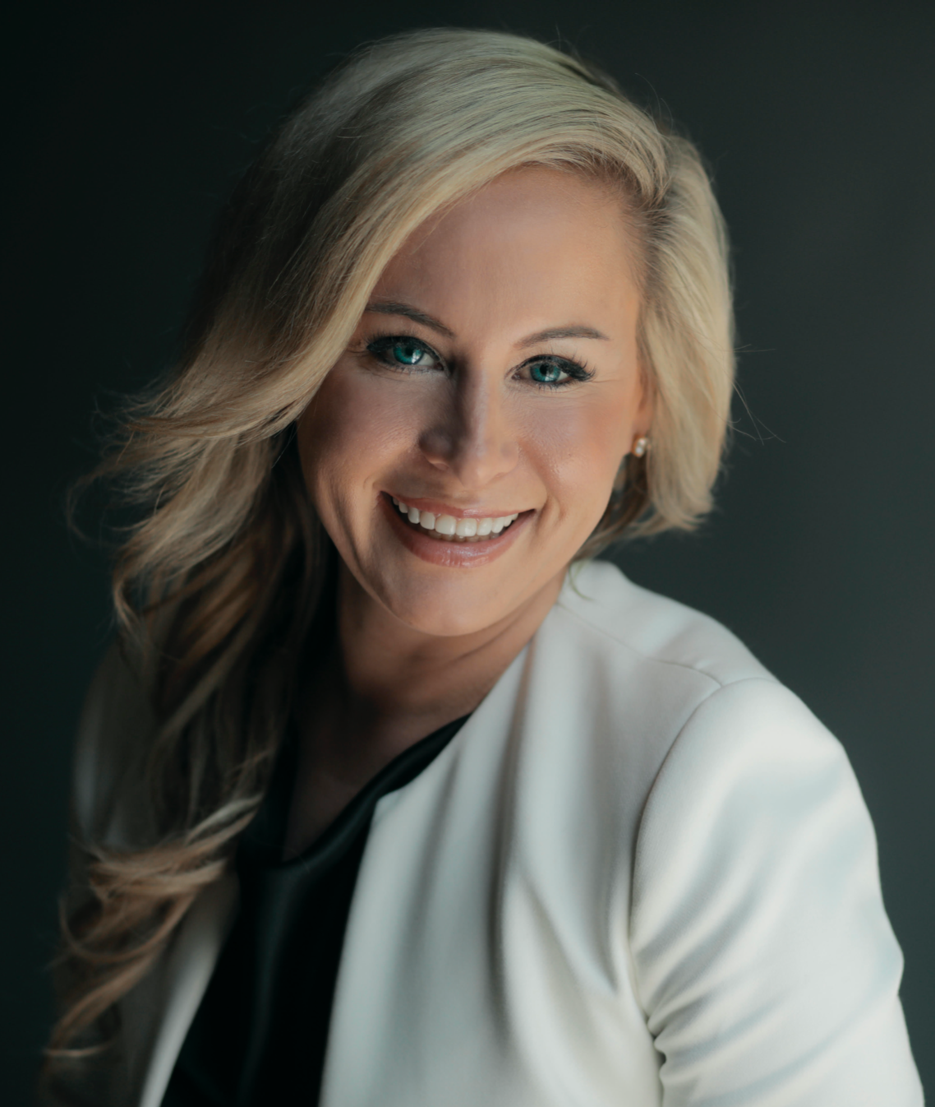

Steven Johnson
Kansas State Treasurer
Tom Treacy
Deputy Assistant State Treasurer
Cell: 785.230.1401 tom@treasurer.ks.gov
Sara Hart Weir
Executive Director
Kansas Council on Developmental Disabilities (KCDD)
Notes:
SHW + TT

